Slide 1

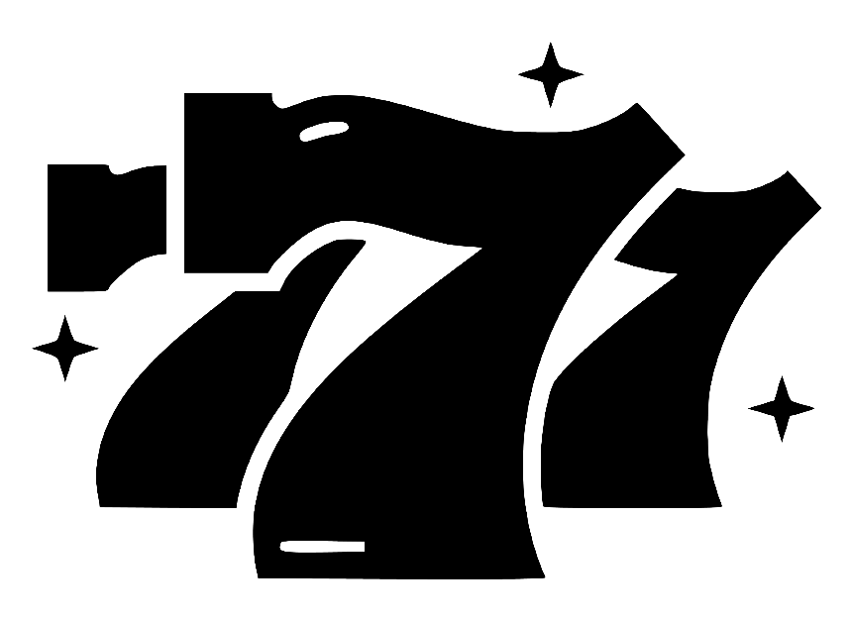

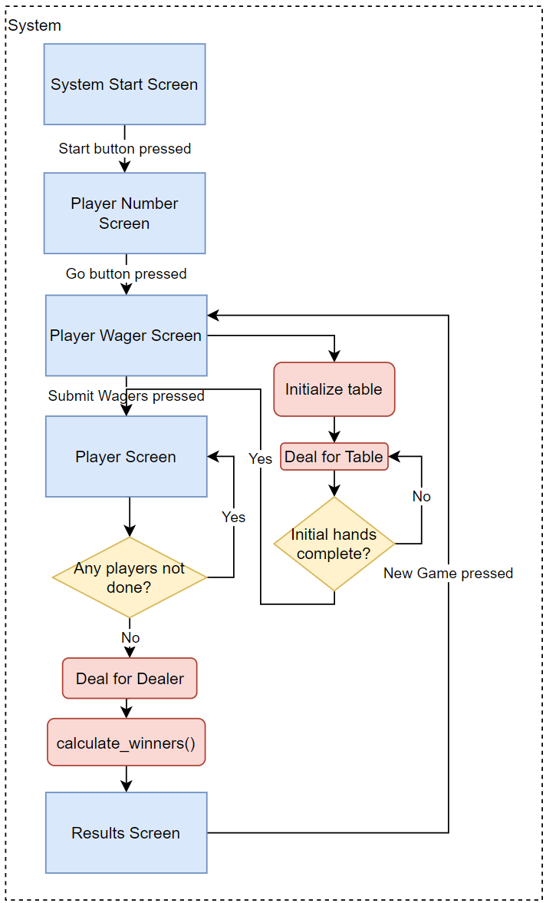
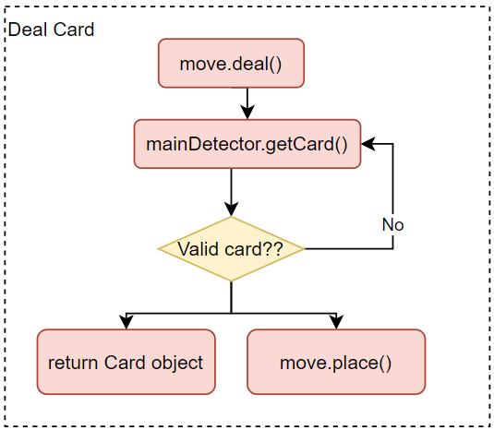
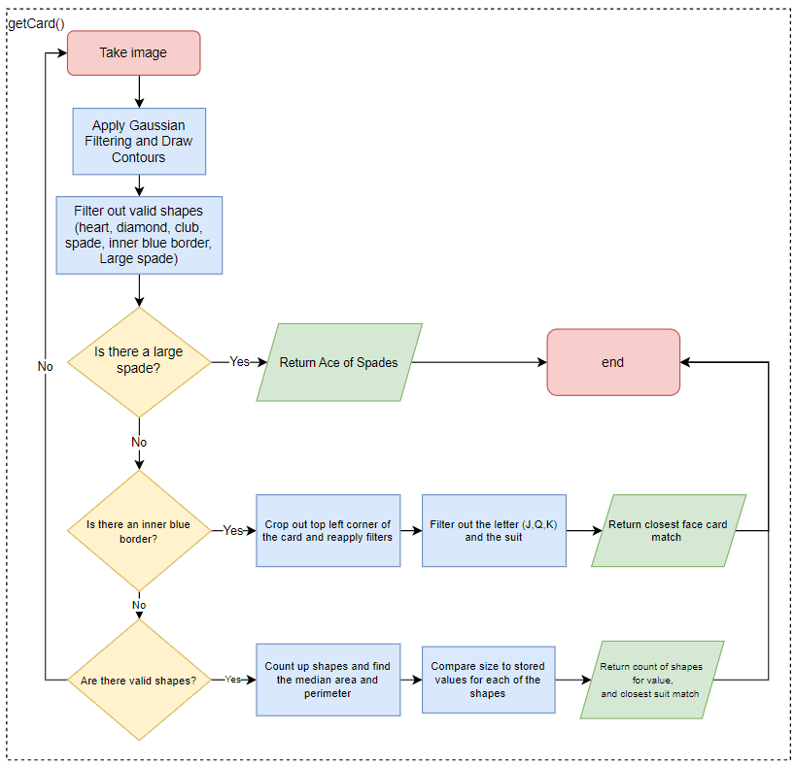
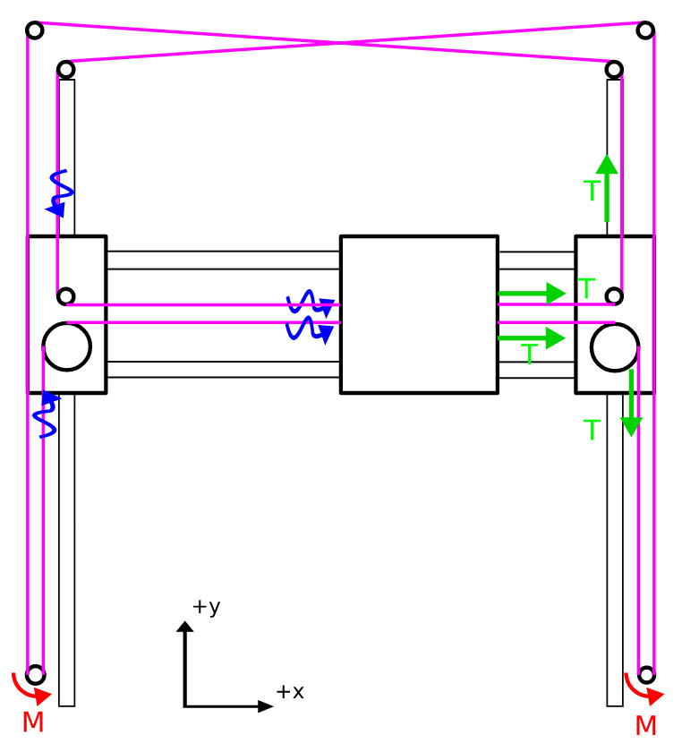
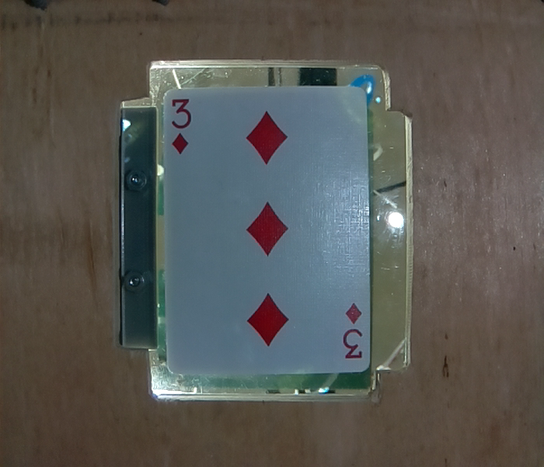

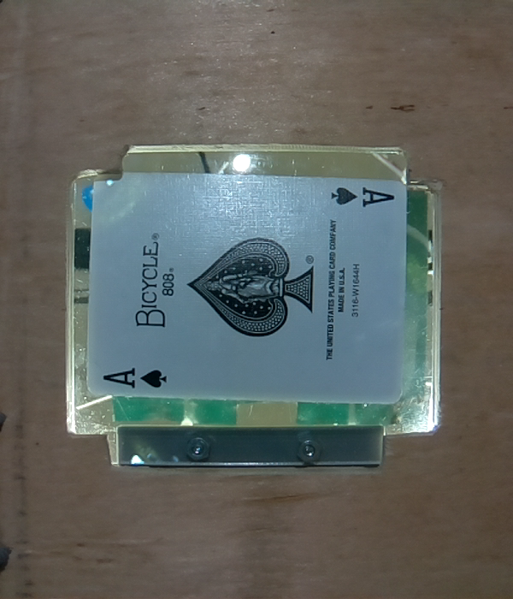

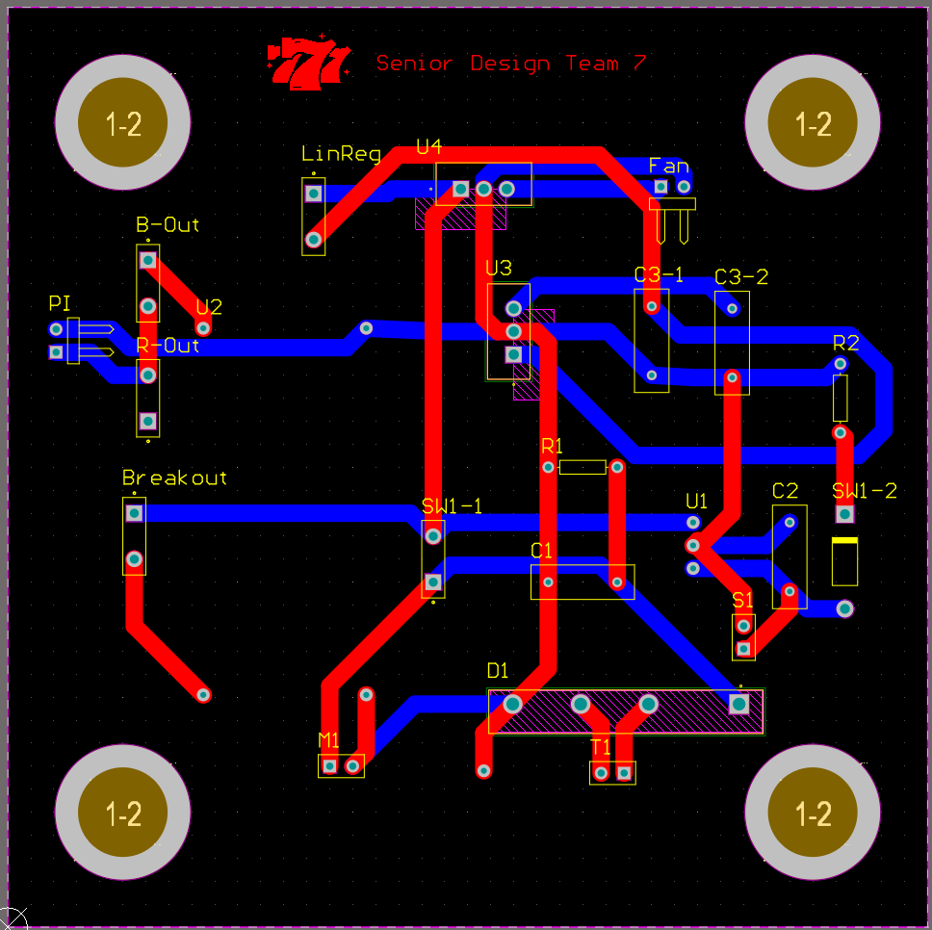
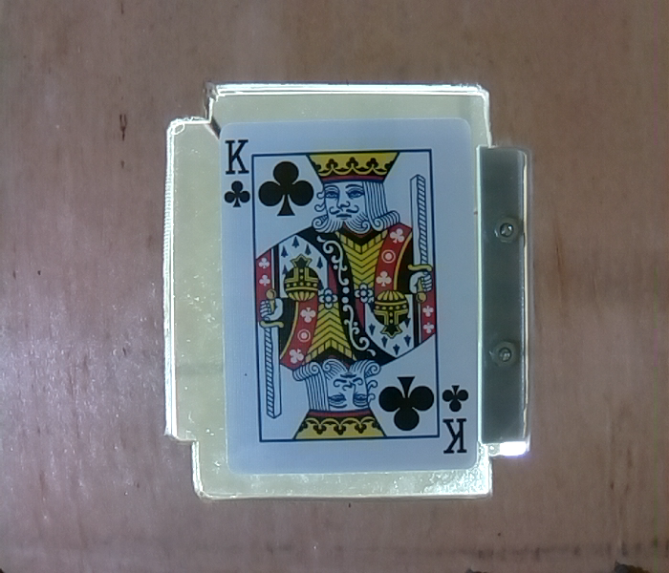

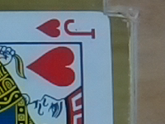
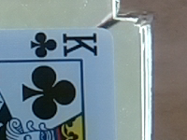
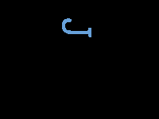


Robotic Blackjack Dealer
Kyle Cullen, Nicholas Lowe(MVP), Curtis Maher, and Luca Mahoney
Department of Electrical and Computer Engineering
Background
System Flowcharts
How to Play
Live table dealers are expensive for casinos to employ.
Players may have mistrust with the dealer.
A robot will reduce cost and leave all gameplay fully visible to the players.
We want to have a dealer working a table on Opening Day of our casino on the Moon.
Future variations of this product will be waterproof for deployment in our casino in the lost city of Atlantis.
Set the wager for each player.
Player orientation matches positioning at the table.
When all players are set, press ‘Submit Wagers’.
Player out your hand. You hand is complete when all buttons are dark.
Press the ‘Next Player’ button to proceed.
When all players complete, the Dealer will play.
Admire your winnings or dread the lack thereof.
Press ‘New Game’ to play again.
CoreXY Gantry Control
Figure 4. Drawing and dealing flow
Rules
This method of gantry control allows for 2-motor control over the entire XY-plane.
The belt configuration reduces twisting forces on the gantry and is more forgiving to structure alignment.
Basic Rules:
All players play against the dealer and not each other.
Numbered cards have point values that match their face. J, Q, and K all have a value of 10. Aces can have a value of 1 or 11.
Get to 21 without going over.
With a hand of less than 21, you may ‘Hit’ to get another card or ‘Stand’ to stop your turn.
Going over is a bust and a loss.
A player may ‘Split’ their hand if both cards on initial deal have the same point value. Each hand is played separately.
A player may ‘Double Down’ on any two card hand. The hand’s wager will double and their hand will receive only one more card.
A player may ‘ Surrender’ any two card hand. This forfeits the hand but returns half of the hand’s wager.
Dealer stands on all 17s.
Winning Conditions:
Player over 21 - Player lose; Payout: 0
Player under 21, Dealer over 21 - Player win; Payout: 1 to 1
Player higher than Dealer, both under 21 - Player win; Payout: 1 to 1
Player lower than Dealer, both under 21 - Player lose; Payout: 0
Player and Dealer tie - Push; Payout: original wager
Player two card 21 - Blackjack win; Payout: 3 to 2
Any two card 21 beats a three cards or greater 21
Figure 3. Entire system game flow
Figure 5. Computer vision flow
Computer Vision
Uses OpenCV with Arducam for Raspberry Pi Camera Module to analyze shapes on each card to identify the Suit and Rank
The image must have one of the three qualifiers:
It must be a valid shape (Diamond, Heart, Club, Spade)
It must have a blue rectangular box (Face Cards)
It must have a single, significantly larger Spade (Ace of Spades)
Average Accuracy: 99.5%
Average Runtime: 2.1225 seconds
Framerate: 608x704 pixels
Figure 1. CoreXY gantry design
System Power
Designed AC-DC conversion circuit for powering systems
Voltage circuits
5V-1A: Vacuum Pump, ring lights.
5V-3A: Raspberry Pi.
12V-1A: Fan
20V-5A (main power): Motors
Figure 6. 3 of D; Pic & Contours
Figure 7. Ace of Spades; Pic and Contour
Acknowledgements
Our team would like to thank the professors of the senior design course, Dr. Mohamed Bayoumy and Dr. Nathan Youngblood. In addition, we thank Brandon Ferruzza, Matthew Rehder, Alexander Short, and Christopher Westerlund from the Naval Nuclear Laboratory for advising on this project and providing insight on our design approach.
Figure 8. King of Clubs; Cropped Pic & Contours
Figure 9. Cropped Jack of Hearts; Pic & Contours
Figure 2. Power PCB

